Slide 1
Chapter 12
SUPERVISED LEARNING
Decision Trees, Rule Algorithms and their Hybrids
Cios / Pedrycz / Swiniarski / Kurgan

Slide 2
Outline
What is Inductive Machine Learning?
- Categorization of ML Algorithms
- Generation of Hypotheses
Decision Trees
Rule Algorithms
- DataSqueezer
Hybrid Algorithms
  - CLIP4
  - Set Covering algorithm

Slide 3
What is Inductive Machine Learning?
How do we understand learning?
We define it as the ability of an agent (like an algorithm) to improve its own performance based on past experience.

Slide 4
What is Inductive Machine Learning?
Machine Learning (ML) can be also defined as the ability of a computer program:
to generate a new data structure that is different from an old one,
like production if…then… rules from input numerical or nominal data

Slide 5
What is Inductive Machine Learning?
The key concept in inductive ML is that of a hypothesis, which is generated by a given algorithm
A hypothesis approximates some concept
We generally assume that only a teacher/oracle knows the true meaning of a concept, and who describes the concept, via means of examples, to a learner whose task is to generate a hypothesis that best approximates the concept
Example: concept of a “pneumonia” can be described by
(high fever, pneumonia)
(weak, pneumonia)

Slide 6
What is Inductive Machine Learning?
Inductive ML algorithms generate hypotheses that approximate concepts;
hypotheses are often expressed in form of production rules, and we say that
the rules “cover” the examples.
We say that an example is covered by a rule when it satisfies all conditions of the IF part of the rule.

Slide 7
What is Inductive Machine Learning?
Any inductive ML process is broken into two phases:
Learning phase, where the algorithm analyzes the data and recognizes similarities among data objects. The result of this analysis is generation of a tree, or equivalent to it set of production rules.
Testing phase, where the rules are evaluated on new data, and some performance measures are computed.

Slide 8
What is Inductive Machine Learning?
ML algorithms can generate explicit rules, which can be inspected, learned from, or modified by users
This is an important advantage of ML over other data mining methods.

Slide 9
What is Inductive Machine Learning?
There are four levels (a pyramid) of knowledge:
Warehouse / Database
(structures that carry original information)
Extracted databases
(databases which contain only extracted useful information from original information)
3. Knowledge
(information generated from the extracted database, for example a set of ML rules)
Meta-knowledge
(knowledge about knowledge)

Slide 10
Categorization of ML algorithms
ML algorithms work in one of two modes:
Supervised Learning / learning from examples
(all patterns have assigned target class)
Unsupervised Learning / learning from observation
(patterns do not have target class)

Slide 11
Categorization of ML algorithms
Unsupervised Learning: learning system on its own discovers classes in the data by discovering common properties (with none or minimal help from the user)
Clustering – finding groups of similar examples
Association Rules - generation of rules describing frequently co-occurring items

Slide 12
Categorization of ML algorithms
Incremental vs. non-incremental
In non-incremental learning all of the training examples are presented simultaneously (as a batch file) to the algorithm.
In incremental learning the examples are presented one at a time, and the algorithm improves its performance based on these new examples without the need of re-training.
Most ML algorithms are non-incremental.

Slide 13
Categorization of ML algorithms
Any supervised learning algorithm must be provided with a training data set. Let us assume that such a set S consists of M training data pairs, belonging to C classes:
S = {(xi ∈ cj) | i = 1,...,M; j = 1,...,C}
training data pairs are often called examples, where xi is an n-dimensional pattern vector whose components are called features/attributes, and cj is a known class.
The mapping function f, c = f(x), is not known.

Slide 14
Categorization of ML algorithms
Supervised Learning: is known as inductive ML or learning from examples. The user, serving role of the teacher, must provide examples describing each concept/class.
Rote learning – the system is “told” the correct rules
Learning by analogy – system is taught the correct response to a similar task; system needs to adapt to the new situation

Slide 15
Categorization of ML algorithms
Case-based learning - the learning system stores all the cases it has studied so far, together with their outcomes. When a new case is encountered the system tries to adapt to this new case the stored previous behavior.
Explanation-based learning - the system analyzes a set of example solutions in order to determine why each was successful (or not).

Slide 16
Categorization of ML algorithms
Conceptual clustering – different from classical clustering, since it is able to deal with nominal data.
Conceptual clustering consists of two tasks:
1) finding clusters in a given data set, and
2) characterization that generates a concept description for each cluster found by clustering.

Slide 17
Categorization of ML algorithms
Inductive vs Deductive Learning
Deduction infers information that is a logical consequence of the information stored in the data. It is provably correct if the data describing some domain are correct.
Induction infers generalized information, or knowledge, from the data by searching for regularities among the data. It is correct for the given data but only plausible outside of the data.

Slide 18
Categorization of ML algorithms
Structured vs Unstructured Algorithms
In learning hypotheses (approximations of concepts) there is a need to choose a description language.
There are two basic types of domains: structured and unstructured.
An example belonging to an unstructured domain is usually described by an <attribute, value> pair. Description languages applicable to unstructured domains are: decision trees, production rules, and decision tables (as used in rough sets).
For domains having an internal structure often a first-order calculus language can be used.

Slide 19
Generation of Hypotheses
target
DECISION | CONDITION1 | CONDITION2 | INDEX
A | low | normal | 2
A | low | normal | 3
A | normal | normal | 3
A | normal | low | 2
A | normal | low | 1
B | low | high | 4
B | low | low | 4
B | high | normal | 4
A | normal | low | 2
A | normal | normal | 2
A | normal | normal | 2
A | normal | normal | 3
A | low | normal | 1
B | normal | high | 4
B | high | low | 4
B | high | normal | 4
A | normal | low | 4
A | low | normal | 2
A | low | normal | 2
A | normal | normal | 4
A | normal | normal | 2
B | low | high | 4
B | high | low | 4
B | high | normal | 4

Slide 20
Generation of Hypotheses
target
DECISION | CONDITION1 | CONDITION2 | INDEX
A | low | normal | 2
A | low | normal | 3
A | normal | normal | 3
A | normal | low | 2
A | normal | low | 1
B | low | high | 4
B | low | low | 4
B | high | normal | 4
A | normal | low | 2
A | normal | normal | 2
A | normal | normal | 2
A | normal | normal | 3
A | low | normal | 1
B | normal | high | 4
B | high | low | 4
B | high | normal | 4
A | normal | low | 4
A | low | normal | 2
A | low | normal | 2
A | normal | normal | 4
A | normal | normal | 2
B | low | high | 4
B | high | low | 4
B | high | normal | 4
RULES for DECISION: A (4 rules)
1. IF CONDITION1 = normal AND CONDITION2 = normal THEN DECISION = A
2. IF INDEX = 2 THEN DECISION = A
3. IF CONDITION1 = normal AND CONDITION2 = low THEN DECISION = A
4. IF CONDITION1 = low AND CONDITION2 = normal THEN DECISION = A
RULES for DECISION: B (3 rules)
1. IF CONDITION1 = high AND INDEX = 4 THEN DECISION = B
2. IF CONDITION1 = low AND INDEX = 4 THEN DECISION = B
3. IF CONDITION1 = normal AND CONDITION2 = high AND INDEX = 4 THEN DECISION = B

Slide 21
Generation of Hypotheses
DECISION | CONDITION1 | CONDITION2 | INDEX
A | low | normal | 2
A | low | normal | 3
A | normal | normal | 3
A | normal | low | 2
A | normal | low | 1
B | low | high | 4
B | low | low | 4
B | high | normal | 4
A | normal | low | 2
A | normal | normal | 2
A | normal | normal | 2
A | normal | normal | 3
A | low | normal | 1
B | normal | high | 4
B | high | low | 4
B | high | normal | 4
A | normal | low | 4
A | low | normal | 2
A | low | normal | 2
A | normal | normal | 4
A | normal | normal | 2
B | low | high | 4
B | high | low | 4
B | high | normal | 4
ASSOCIATION RULES (no “decision” target)
1. DECISION = B AND INDEX = 4
2. CONDITION1 = normal AND CONDITION2 = normal AND INDEX = 2
3. CONDITION2 = normal AND INDEX = 3
4. DECISION = A AND INDEX = 2
etc.

Slide 22









Generation of Hypotheses
Information System
IS = < S, Q, V, f >
where
S is a finite set of examples S = {e₁, ..., e_{i}, ..., e_{M}}
M is the number of examples
Q is a finite set of features Q = {F₁, ..., F_{j}, ..., F_{n}}
n is the number of features
is a set of feature values
is the domain of feature
a value of feature
is an information function such that
for every and

Slide 23
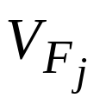
Generation of Hypotheses
Information System
The set S is often called the learning/training data set, which is a subset of the entire universe
(known only to the teacher/oracle),
defined as a Cartesian product of all feature
domains (j=1,2…n).

Slide 24
Generation of Hypotheses
A travel agency tries to learn which customers generate the most profit based on the following data:
1. Type of a call: local, long distance, international.
2. Language fluency of a customer: fluent, fluent with accent, speaks badly, foreign language only.
3. Ticket type: local (0-250 miles), short distance (250-1000 miles), long distance (over 1000 miles).
4. Age of a customer: 1st range: 18-25 years, 2nd range: 25-40 years, 3rd range: 40-60 years, 4th range: 60-80 years, 5th range: 80 and older.
The fifth feature, the decision attribute, is:
5. Purchase ticket: Buy/Not buy
(Buy: positive examples, Not buy: negative examples)

Slide 25
Generation of Hypotheses
S | F1 | F2 | F3 | F4 | F5
Example | Type of call | Lang. fluency | Ticket type | Age | Decision attribute
E1 E2 | Local (1) Local (1) | Fluent (1) Fluent (1) | Long (3) Local (1) | Very young (1) Old (4) | Buy (1) Buy (1)
E3 | Long dist. (2) | Not fluent (3) | Short (2) | Very old (5) | Buy (1)
E4 E5 E6 | Intern. (3) Local (1) Local (1) | Accent (2) Fluent (1) Not fluent (3) | Long (3) Short (2) Short (2) | Very old (5) Middle (3) Very young (1) | Buy (1) Buy (1) Not buy (2)
E7 E8 E9 | Intern. (3) Intern. (3) Local (1) | Fluent (1) Foreign (4) Not fluent (3) | Short (2) Long (3) Long (3) | Middle (3) Young (2) Middle (3) | Not buy (2) Not buy (2) Not buy (2)
IF (F1= 1) AND (F2= 1) THEN F5 = 1
IF Type of call = Local AND Language fluency = Fluent THEN Decision = Buy

Slide 26
Generation of Hypotheses
Information System for the example:
S = {e₁,…e₉}, M = 9
Q = {F₁, …F₅}, n = 5
V_{F1}= {Local, Long dist., International}
V_{F2} = {Fluent, Accent, Not fluent, Foreign}
V_{F3} = {Local, Short, Long}
V_{F4} = {Very young, Young, Middle, Old, Very old}
V_{F5} = {Buy, Not buy}

Slide 27
Generation of Hypotheses
It is important to establish a balance between the rules’ generalization and specialization in order to generate a set of rules that have good predictive power.
A more general rule is one that covers more training positive examples.
A specialized rule, on the other hand, may cover, in an extreme case only one example.

Slide 28
Generation of Hypotheses
The rules can be generalized, or specialized, by using the following common techniques:
Replacing constants with variables (a more general rule is obtained by replacing constants, in rules that have the same outcome, by a variable, and thus merging them into one rule)
IF F1= krystyna THEN student
IF F1= konrad THEN student
IF F1= karol THEN student
can be replaced by a more general rule:
IF F1= Soic THEN student

Slide 29
Generation of Hypotheses
Using disjuncts for rule generalization and conjuncts for rule specialization
IF F1= 1 AND F2= 5 THEN class1
is a more specialized rule (uses conjunct AND) than
IF F1= 1 THEN class1
(OR)
IF F2= 5 THEN class1
(the last two rules are in disjunction, i.e., are connected by a disjunct OR (that is never written explicitly; thus any collection of production rules is always ORed).

Slide 30
Generation of Hypotheses
Moving up in a hierarchy for generalization
If there is a known hierarchy the generalization can be performed by replacing the conditions involving the knowledge at the lower level by the common conditions involving the knowledge at the higher level.
IF F1= canary THEN class = sing
IF F1= nightingale THEN class = sing
can be replaced (if hierarchy of “singbirds” exists) by
IF F1= singbird THEN class = sing
Chunking
Is based on the assumption that given the goal every problem encountered on the way to this goal can be treated as a sub-goal.
Then we can generate rules for each of the sub-goals, and put them together.

Slide 31
Decision Trees
Decision tree consists of nodes and branches connecting the nodes. The nodes located at the bottom of the tree are called leaves, and indicate classes.
The top node in the tree, called the root, contains all training examples that are to be divided into classes.
All nodes, but leaves, in the tree are called decision nodes since they specify a specific decision to be performed at this node based on a single feature.
Each decision node has a number of children nodes, equal to the number of values a given feature assumes.

Slide 32
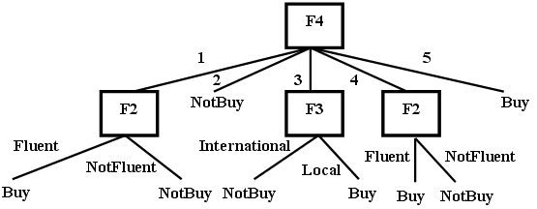
Decision Trees

Slide 33
Decision Trees
All decision tree algorithms are based on Hunt’s fundamental algorithm of concept learning.
This algorithm is an embodiment of a method used by humans when learning simple concepts:
it is done by finding key distinguishing features between two categories, represented by the positive and negative (training) examples.

Slide 34
Decision Trees
Hunt’s algorithm
Given: A set of training examples, S
1. Select the most discriminatory (significant) feature
2. Split the entire set, S, located at the root of the tree, into several subsets using the selected feature. The number of children nodes originating from the root is equal to the number of values the selected feature takes on.
3. Recursively find the most significant feature for each subset generated in step 2 and top-down split it into subsets. If each subset contains examples belonging to one class only (a leaf node) then stop, otherwise go to step 3.
Result: The decision tree from which classification rules can be extracted

Slide 35
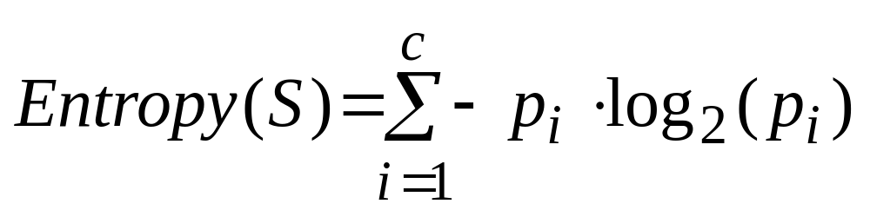
Decision Trees
We can use Shannon’s entropy as a criterion for selecting
the most significant/discriminatory feature:
where: p_{i} - proportion of the examples belonging to the i^{th} class.

Slide 36
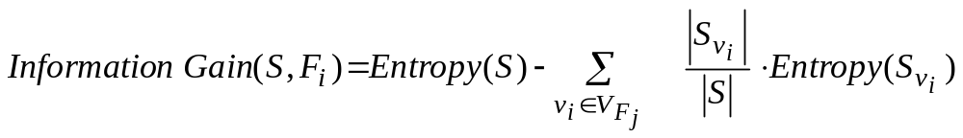
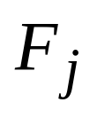
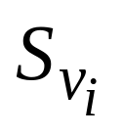

Decision Trees
Information Gain measures expected reduction in entropy caused by knowing the value of a feature F_{j} :
where
is a set of all possible values of feature
is a subset of S, for which feature
has value v_{i}.
Information Gain is used to select the best (reducing the entropy by the largest amount) feature at each step of growing a decision tree.

Slide 37
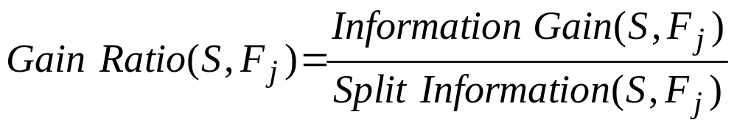
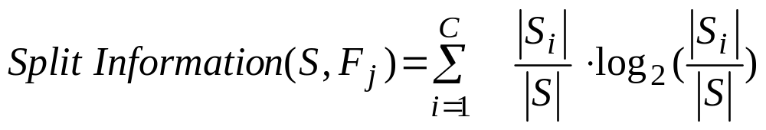
Decision Trees
To compensate for the bias of the Information Gain for cases
with many outcomes, a measure called Gain Ratio is used:
where:
Split Information is the entropy of S with respect to values of feature F_{j}.
In a situation when two or more features have the same value of
Information Gain the feature that has less number of values is selected.
Using gain ratio results in generation of smaller trees.

Slide 38
Decision Trees
ID3 algorithm
Given: A set of training examples, S
1. Create the root node containing the entire set S
2. If all examples are positive, or negative, then stop: decision tree has one node
3. Otherwise (general case)
  3.1 Select feature F_{j} that has the largest Information Gain value
  3.2 For each value v_{i} from the domain of feature F_{j}:
a) add a new branch corresponding to this feature value v_{i}, and a new node, which stores all the examples that have value v_{i} for feature F_{j}
b) if the node stores examples belonging to one class only then it becomes a leaf node, else below this node add a new sub-tree, and go to step 3
Result: A decision tree

Slide 39
Decision Trees
ID3 algorithm uses inductive bias during learning,
namely, it prefers small over large decision trees.
Decision tree in fact consists of disjunctions of conjunctions of the feature values, and thus can be represented by an equivalent set of
IF…THEN… rules

Slide 40
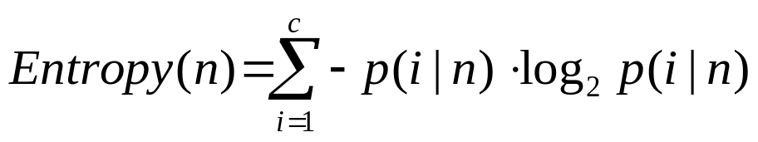
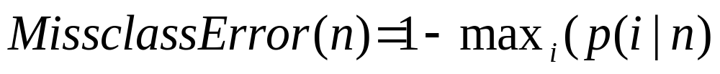
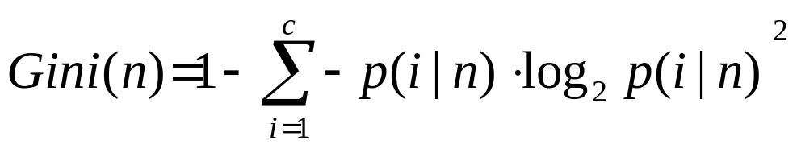
Decision Trees
Other measures for finding the most discriminatory feature for
building decision trees are:
where p(i│n) denotes fraction of examples from class i at node n.
Instead of entropy we can use misclassification error:
or Gini:

Slide 41
Decision Trees
S | F1 | F2 | F3 | F4 | F5
Example | Type of call | Lang. fluency | Ticket type | Age | Decision attribute
E1 E2 | Local (1) Local (1) | Fluent (1) Fluent (1) | Long (3) Local (1) | Very young (1) Old (4) | Buy (1) Buy (1)
E3 | Long dist. (2) | Not fluent (3) | Short (2) | Very old (5) | Buy (1)
E4 E5 E6 | Intern. (3) Local (1) Local (1) | Accent (2) Fluent (1) Not fluent (3) | Long (3) Short (2) Short (2) | Very old (5) Middle (3) Very young (1) | Buy (1) Buy (1) Not buy (2)
E7 E8 E9 | Intern. (3) Intern. (3) Local (1) | Fluent (1) Foreign (4) Not fluent (3) | Short (2) Long (3) Long (3) | Middle (3) Young (2) Middle (3) | Not buy (2) Not buy (2) Not buy (2)
IF (F1= 1) AND (F2= 1) THEN F5 = 1
IF Type of call = Local AND Language fluency = Fluent THEN Decision = Buy

Slide 42
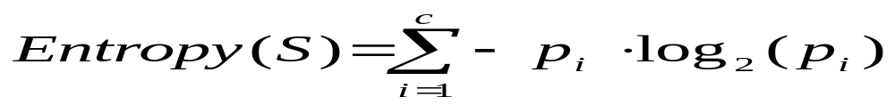
Decision Trees
Example for travel agency:
Next, we calculate for attribute F1 and each of its values the following:
Having the above we calculate the information gain for feature F1 as:

Slide 43
Decision Trees
We perform similar calculations for features F2, F3, and F4, and choose the “best” (in terms of the largest value of the information gain) feature.
This feature is F4, and is used at the root of the tree to split the examples into subsets, which are stored at the children nodes.
Next, at each child node we perform the same calculations to find the best feature, at this level of the decision tree, to split the examples on, until the leaf nodes contain examples belonging to one class only

Slide 44
Decision Trees
IF (F4=1) AND (F2=Fluent(1)) THEN F5=Buy
IF (F4=3) AND (F3=Local(1)) THEN F5=Buy
IF (F4=4) AND (F2=Fluent(1)) THEN F5=Buy
IF (F4=5) THEN F5=Buy (covers 2 examples)

Slide 45
Decision Trees
Methods to overcome overfitting in decision tree algorithms:
Generation of several decision trees instead of one
Windowing
Pruning
After pruning there is no significant loss of the classification accuracy; it helps to generate more general rules.

Slide 46
Decision Trees
Pruning can be done during the process of tree growing - pre-pruning:
we stop tree-growing when it is determined that no attribute will significantly increase the Gain.
Pruning also can be also done after the entire tree is grown –
post-pruning:
some of the branches are removed according to criterion of no significant loss of the rules accuracy on the training data.

Slide 47
Decision Trees
The extreme case of pre-pruning was introduced by Holte who proposed an algorithm called 1RD for building decision trees that are only one-level deep.
He has shown that the classification performance of such trees is comparable with other more complex algorithms.

Slide 48
Decision Trees
Windowing
is a technique to deal with large data
Windowing divides training data into subsets (windows) from which several decision trees are grown.
Then the best rules extracted from these trees are chosen - according to the lowest error-rate on the validation data set.

Slide 49
Decision Trees
C4.5 algorithm is an extension of ID3 that allows for:
using continuous input values, by using build-in front-end discretization algorithm
growing trees on data with missing features values

Slide 50
Decision Trees
Advantages and disadvantages of decision trees:
they reveal relationships between the rules (that can be written out from the tree). Because of this it is easy to see the structure of the data,
produce rules that best describe all the classes in the training data set,
are computationally simple,
may generate very complex (long) rules, which are very hard to prune,
generate large number of corresponding rules. Their number can become excessively large unless pruning techniques are used to make them more comprehensible,
require large amounts of memory to store the entire tree for deriving the rules.

Slide 51
Decision Trees
Decision trees and rule algorithms always create decision boundaries that are parallel to the coordinate axes defined by the features
In other words, they create hypercube decision regions in high-dimensional spaces
An obvious remedy for this shortcoming is to have an algorithm that is able to place a decision boundary at any angle. This idea is used in the Continuous ID3 (CID3) neural network algorithm

Slide 52
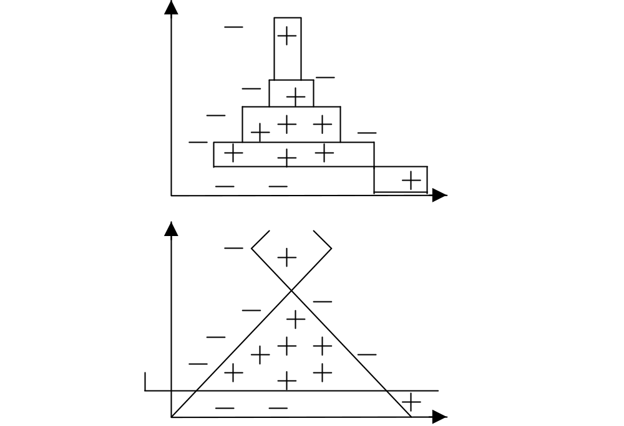
Decision Trees

Slide 53
Rule Algorithms
Rule algorithms are also referred to as rule learners.
Rule induction (generation) is distinct from generation of decision trees.
It is more complex to generate rules directly from data than to write a set of rules from a decision tree.

Slide 54
Rule Algorithms
Algorithm | Complexity
ID3 | O(n)
C4.5 rules | O(n³)
C5.0 | O(n log n)
DataSqeezer | O(n log n)
CN2 | O(n²)
CLIP4 | O(n²)

Slide 55
DataSqueezer Algorithm
Let us denote training dataset by D,
consisting of s examples and k attributes.
The subsets of positive examples, DP, and negative
examples, DN, satisfy these properties:
DP ∪ DN = D, DP ∩ DN = ∅, DN ≠ ∅, and DP ≠ ∅

Slide 56
DataSqueezer Algorithm
The matrix of positive examples is denoted as POS and their number as NPOS;
similarly NEG denotes matrix of negative examples and their number is NNEG.
The POS and NEG matrices are formed by using all positive and negative examples, where examples are represented by rows, and features/attributes by columns.

Slide 57
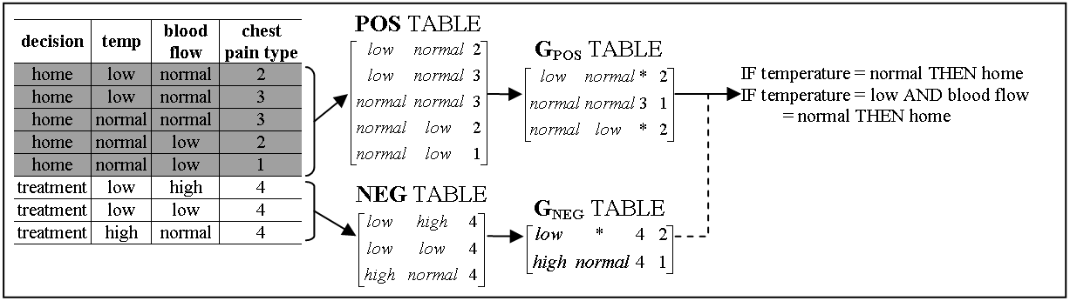
DataSqueezer Algorithm

Slide 58
DataSqueezer Algorithm
Given: POS, NEG, k (number of attributes), s (number of examples)
Step1.
1.1 G_{POS} = DataReduction(POS, k);
1.2 G_{NEG} = DataReduction(NEG k);
Step2.
2.1 Initialize RULES = []; i=1; // where rules_{i} denotes i^{th} rule stored in RULES
2.2 create LIST = list of all columns in G_{POS}
2.3 within every G_{POS} column that is on LIST, for every non missing value a from selected column j compute sum, s_{aj}, of values of gpos_{i}[k+1] for every row i, in which a appears and multiply s_{aj}, by the number of values the attribute j has
2.4 select maximal s_{aj}, remove j from LIST, add “j = a” selector to rules_{i}
2.5.1 if rules_{i} does not describe any rows in G_{NEG}
2.5.2 then remove all rows described by rules_{i} from G_{POS}, i=i+1;
2.5.3 if G_{POS} is not empty go to 2.2, else terminate
2.5.4 else go to 2.3
Output: RULES describing POS
DataReduction (D, k) // data reduction procedure for D=POS or D=NEG
DR.1 Initialize G = []; i=1; tmp = d₁; g₁ = d₁; g₁[k+1]=1;
DR.2.1 for j=1 to N_{D} // for positive/negative data; N_{D} is N_{POS} or N_{NEG}
DR.2.2 for kk = 1 to k // for all attributes
DR.2.3 if (d_{j}[kk] ≠ tmp[kk] or d_{j}[kk] = ‘∗’)
DR.2.4 then tmp[kk] = ‘∗’; // ‘∗’ denotes missing” do not care” value
DR.2.5 if (number of non missing values in tmp ≥ 2)
DR.2.6 then g_{i} = tmp; g_{i}[k+1]++;
DR.2.7 else i++; g_{i} = d_{j}; g_{i}[k+1]=1; tmp = d_{j};
DR.2.8 return G;

Slide 59
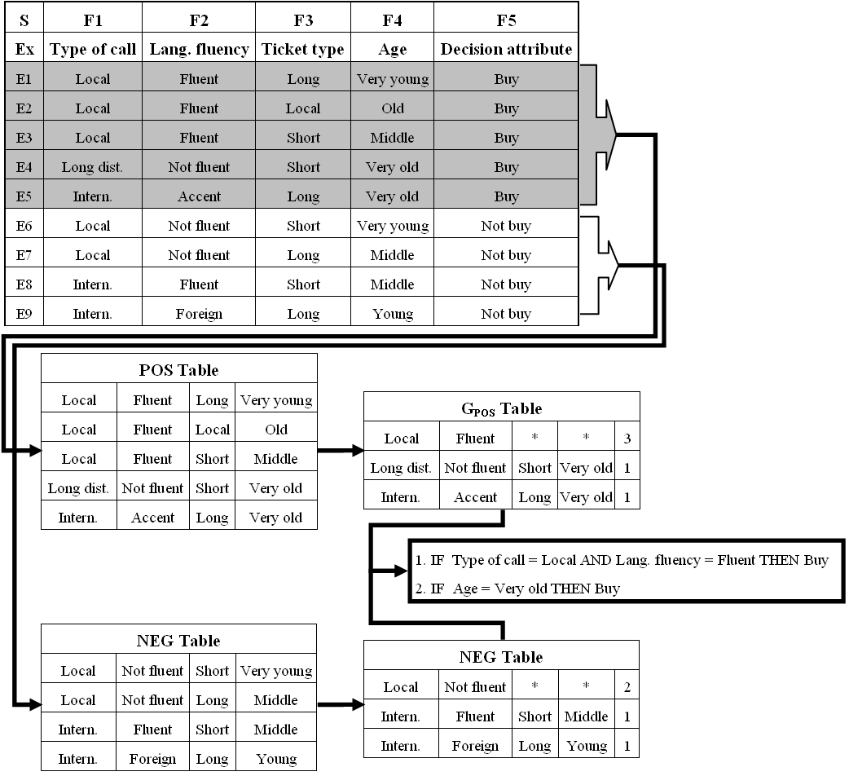

Slide 60
DataSqueezer Algorithm
As result of the above operations the following two rules are generated, which cover all 5 POS training examples:
IF LangFluency = Fluent AND TypeofCall = Local THEN Buy (covers 3 examples)
IF Age = Very old THEN Buy
(covers 2 examples)
or as would the algorithm write it:
IF F2=1 AND F1=1 THEN F5=1 (covers 3 examples)
IF F4=5 THEN F5=1 (covers 2 examples)

Slide 61
DataSqueezer Algorithm
Pruning Threshold is used to prune very specific rules. The rule generation process is terminated if the first selector added to rulei has saj value equal to or smaller than the threshold’s value. The algorithm induces rules by selecting selectors that cover the most of POS examples and removes examples that are already covered.
Generalization Threshold is used to allow for rules that cover a small number of negative data. It allows for accepting rules that cover negative examples; the number equal or smaller than this threshold.

Slide 62
DataSqueezer Algorithm
DataSqueezer generates a set of rules for each class. Two outcomes are possible: a new example is assigned to a particular class, or it is left unclassified. To resolve possible conflicts:
all rules that cover a given example are found. If no rules cover it then it is left unclassified
for every class, the goodness of rules describing this class and covering the example is summed; the example is assigned to the class with the highest value. In case of a tie the example is left unclassified. The goodness value for each rule is equal to the percentage of the POS examples that it covers.

Slide 63
DataSqueezer Algorithm
DataSqeezer treats all unclassified examples as incorrect classifications. As such, they contribute toward lowering the algorithm’s classification accuracy.
This is in contrast to C5.0 and other algorithms that use the default hypothesis, which states that
if an example is not covered by any rule it is assigned to the class with the highest frequency (the default class) in the training data.
This means that each example is always classified, however, this mechanism may lead to significant but artificial improvement in terms of accuracy of the model.
In the extreme case, for highly skewed datasets
(where one of the classes has significantly larger number of training examples)
it may lead to generation of the default hypothesis as the only rule.

Slide 64
DataSqueezer Algorithm
# | abbr. | set | size | #class | #attrib. | test data | # | abbr. | set | size | #class | #attrib. | test data
1 | adult | Adult | 48842 | 2 | 14 | 16281 | 12 | led | LED display | 6000 | 10 | 7 | 4000
2 | bcw | Wisconsin breast cancer | 699 | 2 | 9 | 10CV | 13 | pid | PIMA indian diabetes | 768 | 2 | 8 | 10CV
3 | bld | BUPA liver disorder | 345 | 2 | 6 | 10CV | 14 | sat | StatLog satellite image | 6435 | 6 | 37 | 2000
4 | bos | Boston housing | 506 | 3 | 13 | 10CV | 15 | seg | image segmentation | 2310 | 7 | 19 | 10CV
5 | cid | census-income | 299285 | 2 | 40 | 99762 | 16 | smo | attitude smoking restr. | 2855 | 3 | 13 | 1000
6 | cmc | contraceptive method | 1473 | 3 | 9 | 10CV | 17 | spect | SPECT heart imaging | 267 | 2 | 22 | 187
7 | dna | StatLog DNA | 3190 | 3 | 61 | 1190 | 18 | tae | TA evaluation | 151 | 3 | 5 | 10CV
8 | forc | Forest cover | 581012 | 7 | 54 | 565892 | 19 | thy | thyroid disease | 7200 | 3 | 21 | 3428
9 | hea | StatLog heart disease | 270 | 2 | 13 | 10CV | 20 | veh | StatLog vehicle silhouette | 846 | 4 | 18 | 10CV
10 | ipum | IPUMS census | 233584 | 3 | 61 | 70076 | 21 | vot | congressional voting rec | 435 | 2 | 16 | 10CV
11 | kdd | Intrusion (kdd cup 99) | 805050 | 40 | 42 | 311029 | 22 | wav | waveform | 3600 | 3 | 21 | 3000

Slide 65
Data set | C5.0 | CLIP4 | DataSqueezer
 |  |  | accuracy | sensitivity | specificity
bcw | 94 (±2.6) | 95 (±2.5) | 94 (±2.8) | 92 (±3.5) | 98 (±3.3)
bld | 68 (±7.2) | 63 (±5.4) | 68 (±7.1) | 86 (±18.5) | 44 (±21.5)
bos | 75 (±6.1) | 71 (±2.7) | 70 (±6.4) | 70 (±6.1) | 88 (±4.3)
cmc | 53 (±3.4) | 47 (±5.1) | 44 (±4.3) | 40 (±4.2) | 73 (±2.0)
dna | 94 | 91 | 92 | 92 | 97
hea | 78 (±7.6) | 72 (±10.2) | 79 (±6.0) | 89 (±8.3) | 66 (±13.5)
led | 74 | 71 | 68 | 68 | 97
pid | 75 (±5.0) | 71 (±4.5) | 76 (±5.6) | 83 (±8.5) | 61 (±10.3)
sat | 86 | 80 | 80 | 78 | 96
seg | 93 (±1.2) | 86 (±1.9) | 84 (±2.5) | 83 (±2.1) | 98 (±0.4)
smo | 68 | 68 | 68 | 33 | 67
tae | 52 (±12.5) | 60 (±11.8) | 55 (±7.3) | 53 (±8.4) | 79 (±3.8)
thy | 99 | 99 | 96 | 95 | 99
veh | 75 (±4.4) | 56 (±4.5) | 61 (±4.2) | 61 (±3.2) | 88 (±1.6)
vot | 96 (±3.9) | 94 (±2.2) | 95 (±2.8) | 93 (±3.3) | 96 (±5.2)
wav | 76 | 75 | 77 | 77 | 89
MEAN (stdev) | 78.5 (±14.4) | 74.9 (±15.0) | 75.4 (±14.9) | 74.6 (±19.1) | 83.5 (±16.7)
adult | 85 | 83 | 82 | 94 | 41
cid | 95 | 89 | 91 | 94 | 45
forc | 65 | 54 | 55 | 56 | 90
ipums | 100 | - | 84 | 82 | 97
kdd | 92 | - | 96 | 12 | 91
spect | 76 | 86 | 79 | 47 | 81
MEAN all (stdev) | 80.4 (±14.1) | 75.6 (±14.8) | 77.0 (±14.6) | 71.7 (±23.0) | 80.9 (±19.0)

Slide 66
Data set | C5.0 |  |  | CLIP4 |  |  | DataSqueezer
 | mean # rules | mean # select | # select / rule | mean # rules | mean # select | # select / rule | mean # rules | mean # select | # select / rule
bcw | 16 | 16 | 1.0 | 4 | 122 | 30.5 | 4 | 13 | 3.3
bld | 14 | 42 | 3.0 | 10 | 272 | 27.2 | 3 | 14 | 4.7
bos | 18 | 68 | 3.8 | 10 | 133 | 13.3 | 20 | 107 | 5.4
cmc | 48 | 184 | 3.8 | 8 | 61 | 7.6 | 20 | 70 | 3.5
dna | 40 | 107 | 2.7 | 8 | 90 | 11.3 | 39 | 97 | 2.5
hea | 10 | 21 | 2.1 | 12 | 192 | 16.0 | 5 | 17 | 3.4
led | 20 | 79 | 4.0 | 41 | 189 | 4.6 | 51 | 194 | 3.8
pid | 10 | 22 | 2.2 | 4 | 64 | 16.0 | 2 | 8 | 4.0
sat | 96 | 498 | 5.2 | 61 | 3199 | 52.4 | 57 | 257 | 4.5
seg | 42 | 181 | 4.3 | 39 | 1170 | 30.0 | 57 | 219 | 3.8
smo | 0 | 0 | 0 | 18 | 242 | 13.4 | 6 | 12 | 2.0
tae | 12 | 33 | 2.8 | 9 | 273 | 30.3 | 21 | 57 | 2.7
thy | 7 | 15 | 2.1 | 4 | 119 | 29.8 | 7 | 28 | 4.0
veh | 37 | 142 | 3.8 | 21 | 381 | 18.1 | 24 | 80 | 3.3
vot | 4 | 6 | 1.5 | 10 | 52 | 5.2 | 1 | 2 | 2.0
wav | 30 | 119 | 4.0 | 9 | 85 | 9.4 | 22 | 65 | 3.0
MEAN Stdev | 25.3 (±23.9) | 95.8 (±123.5) | 2.9 (±1.4) | 16.8 (±16.3) | 415.3 (±789.1) | 18.9 (±12.7) | 21.2 (±19.8) | 77.5 (±80.3) | 3.4 (±0.9)
Adult | 54 | 181 | 3.3 | 72 | 7561 | 105.0 | 61 | 395 | 6.5
cid | 146 | 412 | 2.8 | 19 | 1895 | 99.7 | 15 | 95 | 6.3
forc | 432 | 1731 | 4.0 | 63 | 2438 | 38.7 | 59 | 2105 | 35.7
Ipums | 75 | 197 | 2.6 | - | - | - | 108 | 1492 | 13.8
kdd | 108 | 354 | 3.3 | - | - | - | 26 | 409 | 15.7
spect | 4 | 6 | 1.5 | 1 | 9 | 9.0 | 1 | 9 | 9.0
MEAN all stdev | 55.6 (±92.3) | 200.6 (±368.6) | 2.9 (±1.2) | 21.2 (±21.8) | 927.4 (±1800.6) | 28.4 (±28.2) | 27.7 (±27.6) | 261.1 (±520.2) | 6.5 (±7.4)

Slide 67
Hybrid Algorithms
A hybrid algorithm combines methods from two or more types of algorithms
The goal of a hybrid algorithm design is to use the most useful mechanisms from other algorithms, and combine them to achieve better robustness, speed, accuracy, etc.

Slide 68
Hybrid Algorithms
Hybrid algorithms that combine decision trees and rule algorithms:
CN2 algorithm (Clark and Niblett, 1989)
CLIP algorithms
CLILP2 (Cios and Liu, 1995)
CLIP3 (Cios, Wedding and Liu, 1997)
CLIP4 (Cios and Kurgan, 2004)

Slide 69
CLIP4 Algorithm
An important characteristic distinguishing CLIP4 from a vast majority of ML algorithms is that it generates production rules that involve inequalities.
This results in generating small number of compact rules, especially in domains where attributes have large number of values, and where majority of them are correlated with the target class.
Another key characteristic of CLIP4 is its extensive use of the set covering (SC) problem and its novel solution that constitutes its core operation.
The SC is used to select the most discriminating features,
to grow new branches of the tree,
to select data subsets from which it generates the least overlapping rules, and
to generate final rules from the (virtual) tree leafs, which store subsets of the data.

Slide 70
CLIP4’s Set Covering Algorithm
CLIP4’s set covering algorithm is a simplified version of integer programming (IP).
Several simplifications are made to the IP model to transform it into the SC problem:
a) the function that is subject of optimization has all coefficients set to one,
b) their variables are binary, x_{i}={0,1},
c) constraint function coefficients are also binary, and
d) all constraint functions are greater or equal to one.
The SC problem is NP-hard.

Slide 71
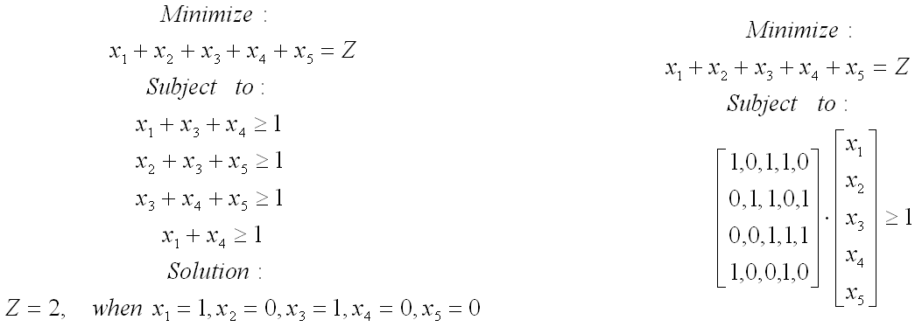
CLIP4’s Set Covering Algorithm

Slide 72
CLIP4’s Set Covering Algorithm
Given: BINary matrix, Initialize: Remove all empty (non-active) rows from the BINary matrix; if the matrix has no 1’s then return error.
1. Select active rows that have the minimum number of 1’s in rows – min-rows
2. Select columns that have the maximum number of 1’s within the min-rows – max-columns
3. Within max-columns find columns that have the maximum number of 1’s in all active rows – max-max-columns, if there is more than one max-max-column go to 4., otherwise go to 5.
4. Within max-max-columns find the first column that has the lowest number of 1’s in the inactive rows
5. Add the selected column to the solution
6. Mark the inactive rows, if all the rows are inactive then terminate; otherwise go to 1.
where: the active row is the row that is not covered by the partial solution, and the inactive row is the row that is already covered by the partial solution.

Slide 73
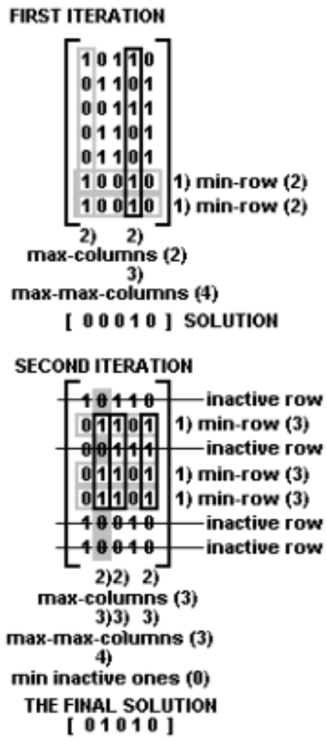
CLIP4’s Set
Covering Algorithm

Slide 74
CLIP4 Algorithm
The set of all training examples is denoted by S.
A subset of positive examples is denoted by SP and the subset of negative examples by SN.
SP and SN are represented by matrices whose rows represent examples and columns correspond to attributes.
Matrix of the positive examples is denoted as POS and their number by NPOS. Similarly for the negative examples we have matrices NEG and NNEG, respectively.
The following properties are satisfied for the subsets:
SP ∪ SN=S, SP ∩ SN=∅, SN ≠ ∅, and SP ≠ ∅

Slide 75
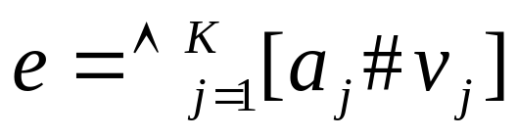
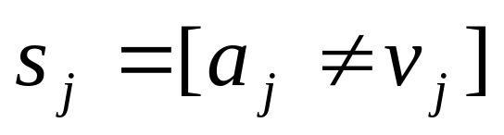
CLIP4 Algorithm
Examples are described by a set of K attribute-value pairs:
where a_{j} denotes j^{th} attribute with value v_{j} ∈ d_{j}, # is a
relation (≠, =, <, ≈, ≤, etc.), where K is the number of attributes.
An example e consists of set of selectors
The CLIP4 algorithm generates rules in the form:
IF (s₁∧…∧s_{m}) THEN class = class_{i}
where all selectors are only in the form s_{i} = [a_{j} ≠ v_{j}], namely,
use only inequalities.

Slide 76
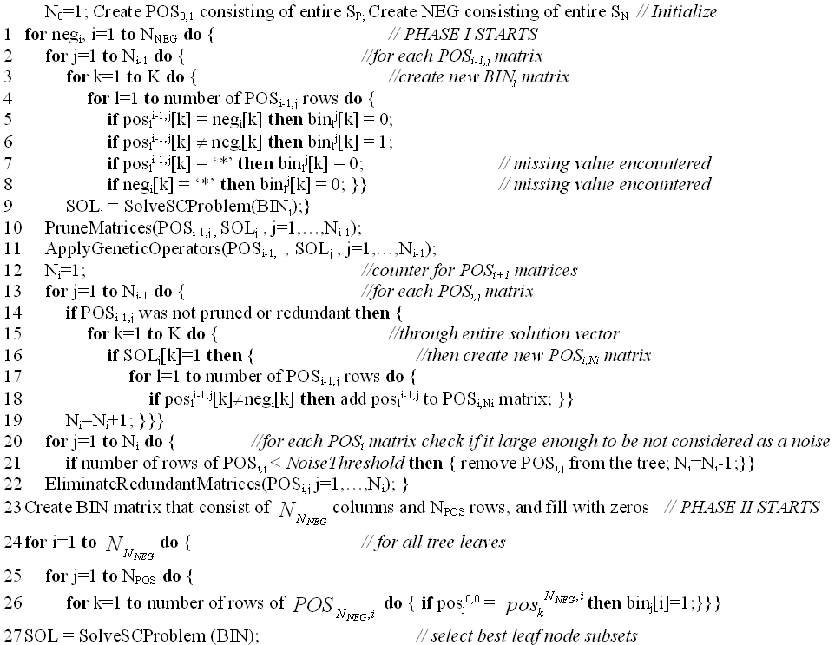
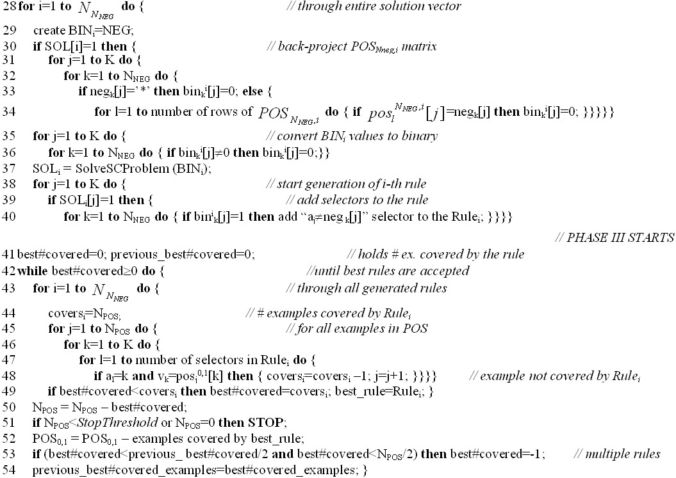
CLIP4 Algorithm

Slide 77
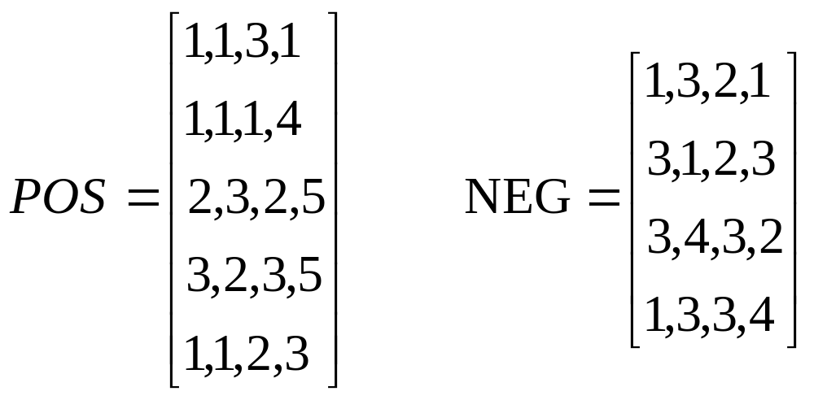
CLIP4 Algorithm

Slide 78
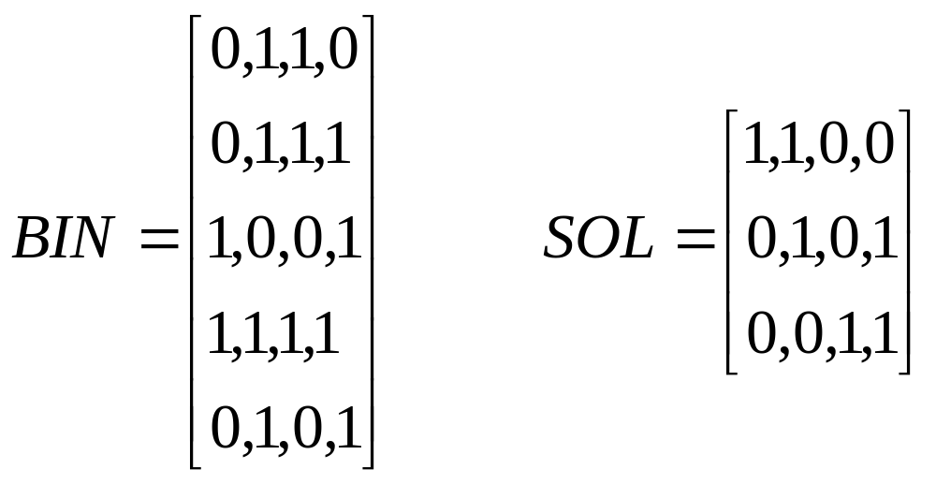
CLIP4 Algorithm
Phase 1: Using the first negative example [1,3,2,1] and matrix POS
we obtain the following binary matrix

Slide 79
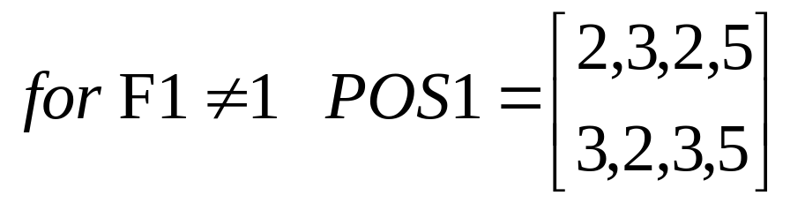
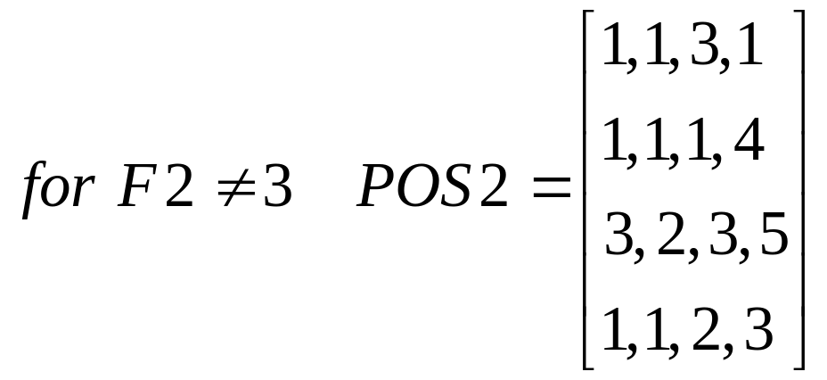
CLIP4 Algorithm

Slide 80
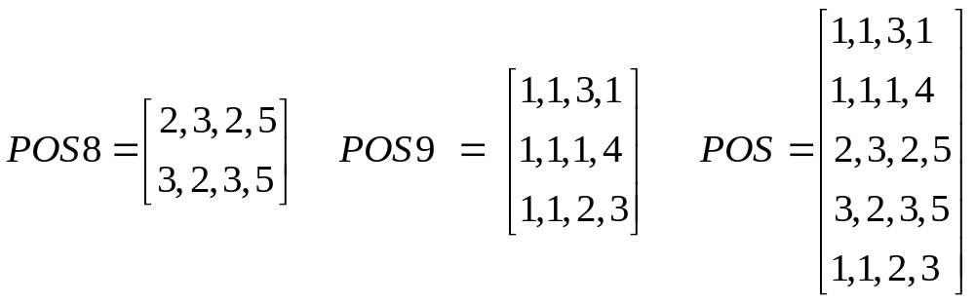
CLIP4 Algorithm
Phase 2: After repeating the process illustrated above, at the end of
Phase 1 we end up with just two matrices (the leaf nodes of the virtual
decision tree); the matrix numbers 8 and 9 are not important:

Slide 81
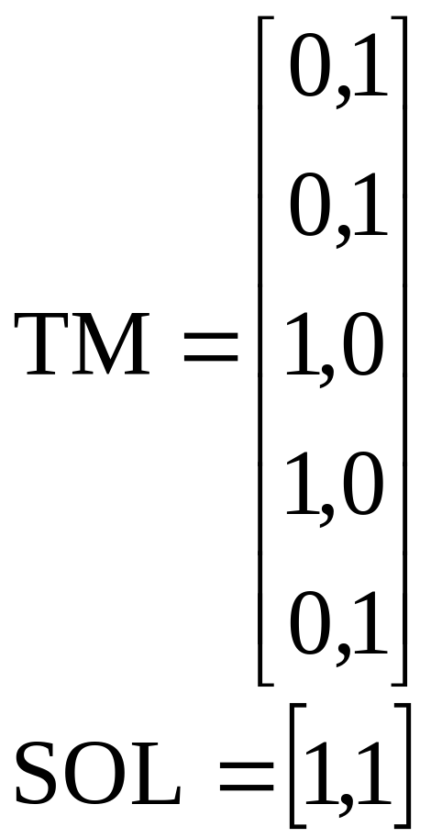
CLIP4 Algorithm

Slide 82
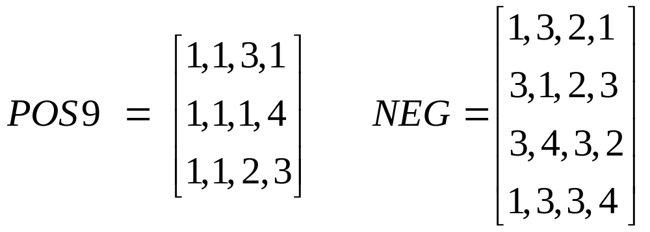
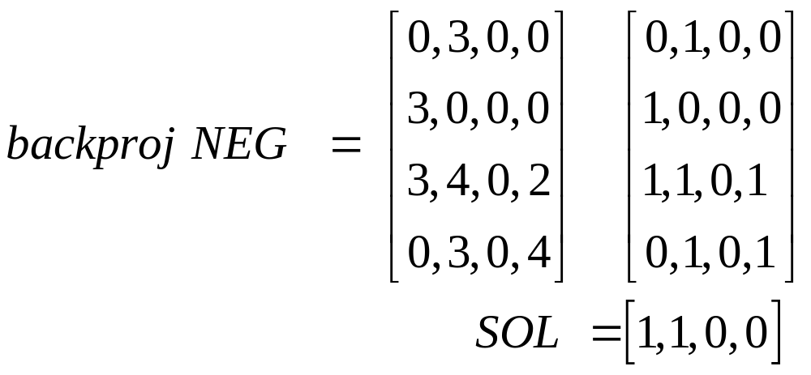
CLIP4 Algorithm

Slide 83
CLIP4 Algorithm
From this solution and from the backproj NEG matrix we generate the first rule:
IF (F1≠3) AND (F2≠3) AND (F2≠4) THEN F5=Buy
(covers examples e1,e2 and e5)
By the same process, using POS8, we generate one more rule:
IF (F4≠1) AND (F4≠3) AND (F4≠2) AND (F4≠4)
THEN F5=Buy
(covers examples e3 and e4)

Slide 84
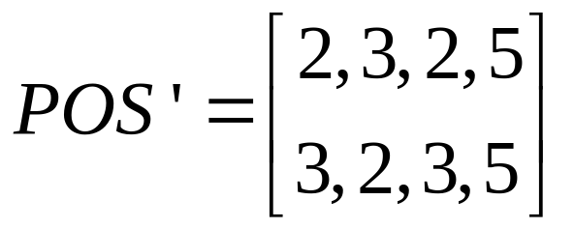
CLIP4 Algorithm
Phase 3: Using the CLIP4’s heuristic, however, we choose only the
first rule and remove from matrix POS all examples covered the first
rule. Next, we repeat the entire process on the reduced matrix POS:
After going again through all the phases of the algorithm we generate
just one rule:
IF (F4≠1) AND (F4≠3) AND (F4≠2) AND (F4≠4) THEN F5=Buy

Slide 85
CLIP4 Algorithm
As the final outcome, in two iterations, the algorithm generated a set of rules that cover all positive examples and none of the negative:
IF (F1≠3) AND (F2≠3) AND (F2≠4) THEN F5=Buy
IF (F4=5) THEN F5=Buy
Notice that by knowing feature values for attribute F4 it is possible to convert the second rule into the equalities rule, as written above.
Verbally the two rules say:
IF Call ≠ International AND Language Fluency ≠ Bad AND Language Fluency ≠ Foreign THEN Buy
IF Customer is 80 years or older THEN Buy

Slide 86
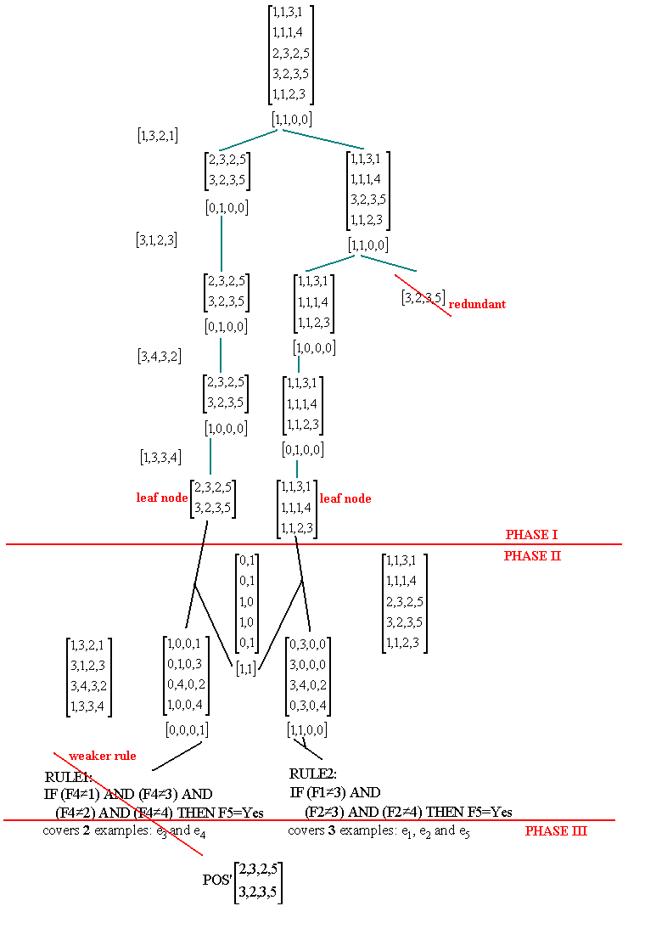
CLIP4 Algorithm

Slide 87
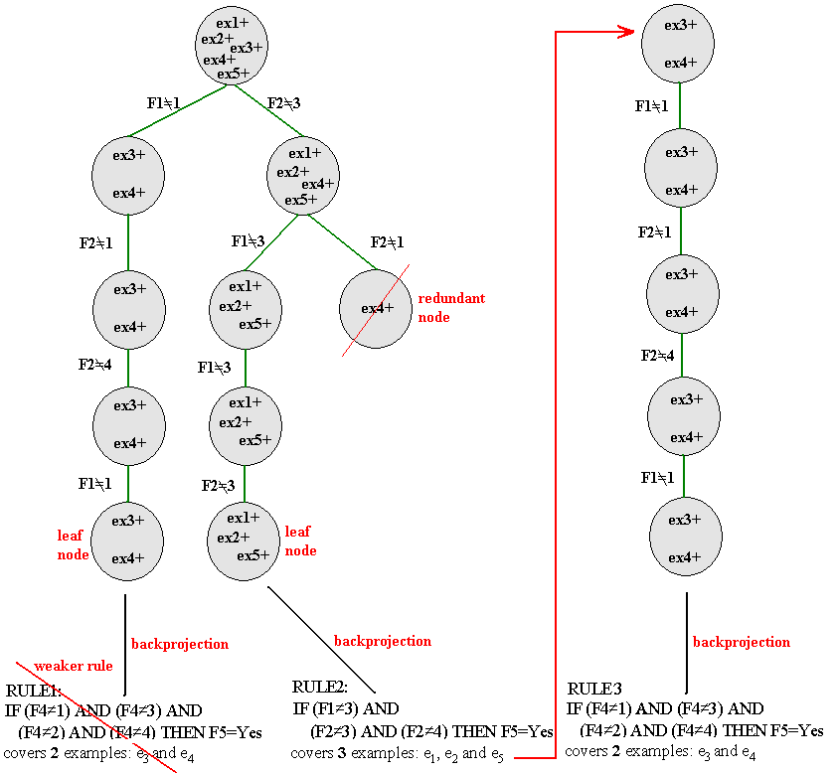
CLIP4
Algorithm

Slide 88
Handling of Missing Values
ex. # | F1 | F2 | F3 | F4 | class
1 | 1 | 2 | 3 | * | 1
2 | 1 | 3 | 1 | 2 | 1
3 | * | 3 | 2 | 5 | 1
4 | 3 | 3 | 2 | 2 | 1
5 | 1 | 1 | 1 | 3 | 1
6 | 3 | 1 | 2 | 5 | 2
7 | 1 | 2 | 2 | 4 | 2
8 | 2 | 1 | * | 3 | 2
IF F1≠3 AND F1≠2 AND F3≠2 THEN class 1 (covers 1,2,5)
IF F2≠2 AND F2≠1 THEN class 1 (covers 2,3,4)
They cover all positive examples, including those with missing values
and none of the negative examples. Notice that both cover the second
example.

Slide 89
Thresholds
Noise Threshold determines which nodes are pruned from the tree grown in Phase 1. The threshold prunes every node that contains less number of examples than its value.
Pruning Threshold is used to prune nodes from the generated tree. It uses a goodness value to perform selection of the nodes. The threshold selects the first few nodes with the highest value and removes the remaining nodes from the tree.
Stop Threshold stops the algorithm when smaller than the threshold number of positive examples remains uncovered.
CLIP4 generates rules by partitioning the data into subsets containing similar examples, and removes examples that are covered by the already generated rules.
The noise and stop thresholds are specified as percentage of the size of positive data and thus are easily scalable.

Slide 90
Use of GA Operators to Improve Accuracy
CLIP4 uses the GA in Phase I to enhance the partitioning of the data and obtain more “general” leaf node subsets. The components of the genetic module are:
population and individual
Individual/chromosome is defined as a node in the tree and consists of: POS_{i,j} matrix (jth matrix at the ith tree level) and SOL_{i,j} (the solution to the SC problem obtained from POS_{i,j} matrix)
Population is defined as a set of nodes at the same level of the tree.
encoding and decoding scheme
There is no need for encoding using the individuals defined above since GA operators are used on the binary SOL_{i,j} vector.

Slide 91
Use of GA Operators to Improve Accuracy
selection of the new population
Initial population is the first tree level that consists of at least two nodes. CLIP4 uses the following fitness function to select the most suitable individuals for the next generation:
The fitness value is calculated as the number of rows of the POS_{i,j} matrix divided by the number of 1’s from the SOL_{i,j} vector. The fitness function has high values for the tree nodes that consist of large number of examples with low branching factor.

Slide 92
Use of GA Operators to Improve Accuracy
The mechanism for selecting individuals for the next population is as follows:
all individuals are ranked using the fitness function
half of the individuals with the highest fitness are automatically selected for the next population (they will branch to create nodes for the next tree level)
the second half of the next population is generated by matching the best with the worst individuals (the best with the worst, the second best with the second worst, etc.) and applying GA operators to obtain new individuals (new nodes in the tree).

Slide 93
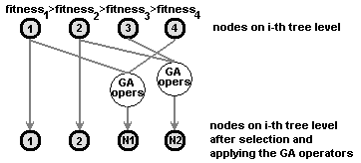
Use of GA Operators to Improve Accuracy

Slide 94
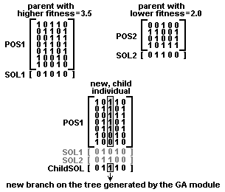
Use of GA Operators to Improve Accuracy

Slide 95
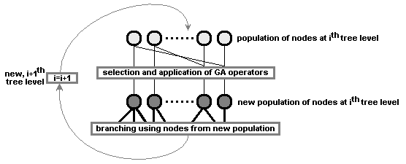
Use of GA Operators to Improve Accuracy

Slide 96
Pruning
CLIP4 prunes the tree grown in Phase 1 as follows:
first, it selects a number (via the pruning threshold) of best nodes on the ith tree level. The selection is performed based on the goodness criterion. Only the selected nodes are used to branch into new nodes, and are passed to the (i+1)th tree level.
second, all redundant nodes that resulted from the branching process are removed. Two nodes are redundant if one mode contains positive examples that are identical, or form a subset of positive examples of the other node.
third, after the redundant nodes are removed, each new node is evaluated using the noise threshold. If it contains less examples than the one specified by the noise threshold then it is pruned.

Slide 97
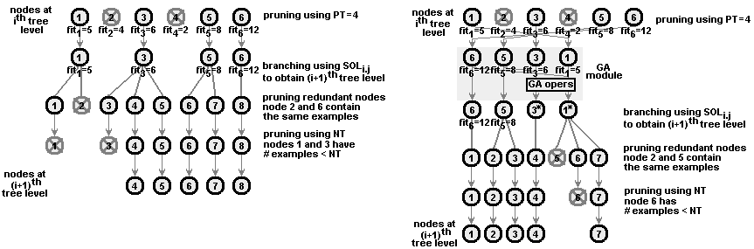
Pruning

Slide 98
Feature and Selector Ranking
Goodness of each attribute and selector is computed using a set of generated rules. All attributes with goodness value greater than zero are strongly relevant, which means that the attribute cannot be removed without decreasing accuracy of classification. The attribute and selector goodness values are computed as follows:
Each generated rule has a goodness value equal to the percentage value of the training positive examples it covers.
Each selector has a goodness value equal to the goodness of the rule it comes from.
For each attribute, the sum of scaled goodness for all its selectors is computed and divided by the number of attribute values to obtain the goodness of the attribute.

Slide 99
Feature and Selector Ranking
Suppose we have a two-category data, described by five attributes a1 through a5, that assume the following vales
a1 = {1, 2, 3}, a2 = {1, 2, 3}, a3 = {1, 2}, a4 = {1, 2, 3}, a5 = {1, 2, 3, 4}, while a6 = {1, 2} is the decision attribute.
Suppose CLIP4 generated the following rules from the data:
IF a5≠2 and a5≠3 and a5≠4 THEN class = 1
(covers 46% (29/62) positive examples)
IF a1≠1 and a1≠2 and a2≠2 and a2≠1 THEN class = 1
(covers 27% (17/62) positive examples)
IF a1≠1 and a1≠3 and a2≠3 and a2≠1 THEN class = 1
(covers 24% (15/62) positive examples)
IF a1≠2 a1≠3 and a2≠2 and a2≠3 THEN class = 1
(covers 14% (9/62) positive examples)

Slide 100
Feature and Selector Ranking
After conversion, and using the information about attribute values we can obtain equality rules:
IF a5=1 THEN class = 1
(covers 46% (29/62) positive examples)
IF a1=3 and a2=3 THEN class = 1
(covers 27% (17/62) positive examples)
IF a1=2 and a2=2 THEN class = 1
(covers 24% (15/62) positive examples)
IF a1=1 and a2=1 THEN class = 1
(covers 14% (9/62) positive examples)

Slide 101
Feature and Selector Ranking
We calculate goodness values for the selectors, shown below in descending order (after doing it we can calculate goodness of attributes):
(a5, 1); goodness 46
(a1, 3) and (a2, 3); goodness 27
(a1, 2) and (a2, 2); goodness 24
(a1, 1) and (a2, 1); goodness 14
In order to show their relative goodness they are scaled to the 0-100 range:
(a5, 1); goodness 100
(a1, 3) and (a2, 3); goodness 58.7
(a1, 2) and (a2, 2); goodness 52.2
(a1, 1) and (a2, 1); goodness 30.4

Slide 102
Feature and Selector Ranking
Thus, for attribute a1 we have the following selectors and their goodness values:
(a1,3) with goodness 58.7, (a1,2) with goodness 52.2, and (a1,1) with goodness 30.4. From this we calculate goodness of the first attribute a1 as follows:
(58.7+52.2+30.4)/3 = 47.1
Similarly we calculate goodness of a2. For attribute a5, however, we have the following selectors and their goodness values: (a5,1) with goodness 100, (a5,2) until 4 with goodness of 0, thus its goodness is calculated as:
(100+0+0+0)/4 = 25.0
The remaining attributes, namely a3, a4 and a6 have all goodness value of 0 because they were not used in the generated rules.

Slide 103
Feature and Selector Ranking
The feature and selector ranking performed by CLIP4 algorithm can be used to:
Select only relevant attributes (features) and discard irrelevant ones. The user can discard all attributes that have goodness of 0 and still have correct (with the same accuracy) model of the data.
Provide additional insight into data properties. The selector ranking can help in analyzing the data in terms of relevance of the selectors to the classification task.

Slide 104
References
Cios K.J. and Liu N. 1992. Machine learning in generation of a neural network architecture: a Continuous ID3 approach. IEEE Trans. on Neural Networks, 3(2):280‑291
Cios, K.J., Pedrycz, W. and Swiniarski, R. 1998. Data Mining Methods for Knowledge Discovery. Kluwer
Kurgan, L. and Cios, K.J. 2002. CAIM Discretization Algorithm, IEEE Trans. on Knowledge and Data Engineering, 16(2): 145-153
Cios, K.J. and Kurgan, L. 2004. CLIP4: Hybrid Inductive Machine Learning Algorithm that Generates Inequality Rules. Information Sciences, 163 (1-3): 37-83
Kurgan L., Cios K.J. and Dick S. 2006. Highly Scalable and Robust Rule Learner: Performance Evaluation and Comparison, IEEE Trans. on Systems Man and Cybernetics, Part B, 36(1):32-53

